Slide 1
John 3 : 1 - 21

Slide 2
3 Now there was a man of the Pharisees named Nicodemus, a member of the Jewish ruling council. ² He came to Jesus at night and said, “Rabbi, we know you are a teacher who has come from God. For no one could perform the miraculous signs you are doing if God were not with him.”
³ In reply Jesus declared, “I tell you the truth, no one can see the kingdom of God unless he is born again.”
⁴ “How can a man be born when he is old?” Nicodemus asked. “Surely he cannot enter a second time into his mother’s womb to be born!”

Slide 3
⁵ Jesus answered, “I tell you the truth, no one can enter the kingdom of God unless he is born of water and the Spirit. ⁶ Flesh gives birth to flesh, but the Spirit gives birth to spirit. ⁷ You should not be surprised at my saying, ‘You must be born again.’ ⁸ The wind blows wherever it pleases. You hear its sound, but you cannot tell where it comes from or where it is going. So it is with everyone born of the Spirit.”
⁹ “How can this be?” Nicodemus asked.

Slide 4
¹⁰ “You are Israel’s teacher,” said Jesus, “and do you not understand these things? ¹¹ I tell you the truth, we speak of what we know, and we testify to what we have seen, but still you people do not accept our testimony. ¹² I have spoken to you of earthly things and you do not believe; how then will you believe if I speak of heavenly things? ¹³ No one has ever gone into heaven except the one who came from heaven—the Son of Man. ¹⁴ Just as Moses lifted up the snake in the desert, so the Son of Man must be lifted up, ¹⁵ that everyone who believes in him may have eternal life.

Slide 5
¹⁶ “For God so loved the world that he gave his one and only Son, that whoever believes in him shall not perish but have eternal life. ¹⁷ For God did not send his Son into the world to condemn the world, but to save the world through him. ¹⁸ Whoever believes in him is not condemned, but whoever does not believe stands condemned already because he has not believed in the name of God’s one and only Son. ¹⁹ This is the verdict: Light has come into the world, but men loved darkness instead of light because their deeds were evil. ²⁰ Everyone who does evil hates the light, and will not come into the light for fear that his deeds will be exposed. ²¹ But whoever lives by the truth comes into the light, so that it may be seen plainly that what he has done has been done through God.”

Slide 6
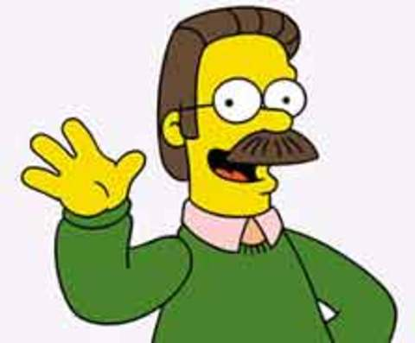
The Born Again Christian……..

Slide 7
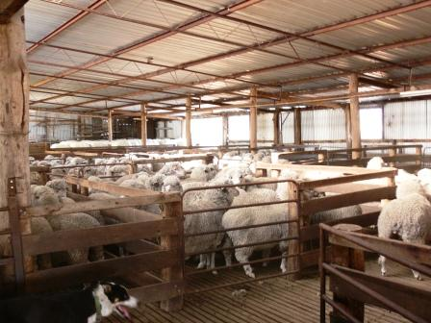
The Truth:
no one can see the Kingdom of God unless he is born again
Living in a Christian country doesn’t make you a Christian any more than living in a shearing shed will make you a sheep.

Slide 8
The Truth:
no one can see the Kingdom of God unless he is born again
Growing up in the church ≠ being born again
Having Christian parents ≠ being born again
Going to church every Sunday ≠ being born again
Being a good person ≠ being born again
Being born again is not a test of having one definitive moment – It is the evidence of the Spirit within
born of water (baptism – repentance of sin, and water and Spirit are a unified concept [living water])
being born again is being born into the Kingdom of God, where the Holy Spirit dwells within the life of the believer

Slide 9
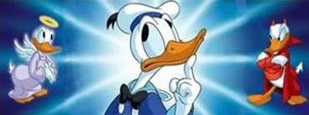
The war between flesh and Spirit
⁶ Flesh gives birth to flesh, but the Spirit gives birth to spirit.
Without Christ, even our righteous acts are works of the flesh

Slide 10
The Truth:
no one can see the Kingdom of God unless he is born again
Being born again is not a test of having one definitive moment – It is the evidence of the Spirit within
Growing up in the church ≠ being born again
Having Christian parents ≠ being born again
Going to church every Sunday ≠ being born again
Being a good person ≠ being born again
born of water (1. baptism – repentance of sin, and 2. water and Spirit are a unified concept [living water])
being born again is being born into the Kingdom of God, where the Holy Spirit dwells within the life of the believer
How and when the Spirit touches a life is God’s domain (whether we come to faith through one defining moment or through a gradual process is The Spirit’s doing and choosing)

Slide 11
No one can see the Kingdom of God unless he is born again
born of water (1. baptism – repentance of sin, and 2. water and Spirit are a unified concept [living water])
being born again is being born into the Kingdom of God, where the Holy Spirit dwells within the life of the believer
How and when the Spirit touches a life is God’s domain (whether we come to faith through one defining moment or through a gradual process is The Spirit’s doing and choosing)
Am I born again????
Is my life being controlled by the flesh? Or by the Spirit of God?

Slide 12
^{Rom 8:5} Those who live according to the sinful nature have their minds set on what that nature desires; but those who live in accordance with the Spirit have their minds set on what the Spirit desires. ⁶ The mind of sinful man is death, but the mind controlled by the Spirit is life and peace; ⁷ the sinful mind is hostile to God. It does not submit to God's law, nor can it do so. ⁸ Those controlled by the sinful nature cannot please God.
⁹ You, however, are controlled not by the sinful nature but by the Spirit, if the Spirit of God lives in you. And if anyone does not have the Spirit of Christ, he does not belong to Christ.

Slide 13
No one can see the Kingdom of God unless he is born again
born of water (1. baptism – repentance of sin, and 2. water and Spirit are a unified concept [living water])
being born again is being born into the Kingdom of God, where the Holy Spirit dwells within the life of the believer
How and when the Spirit touches a life is God’s domain (whether we come to faith through one defining moment or through a gradual process is The Spirit’s doing and choosing)
Am I born again????
Is my life being controlled by the flesh? Or by the Spirit of God?
It’s not just about being good, or just about believing in Jesus...
It’s about giving ourselves to Jesus Christ as Lord
To give ourselves to God
To believe in the Lord Jesus Christ
To be born through the waters of repentance and Baptism

